Slide 1
EXPRESSIONISM
The art of German Expressionism evolved as a result of militarism, economic depression, rampant inflation, dictatorship, and the climactic horror of World War 1 and the Nazi era. Artists produced images based on emotion, with messages that delivered statements about the human condition. Expressionism was often shocking and rugged. It was designed to disturb the viewer to “react” and think about the message.
http://www.sde.idaho.gov/InternationalEducation/docs/Germany/ArtLessonGermany.pdf

Slide 2
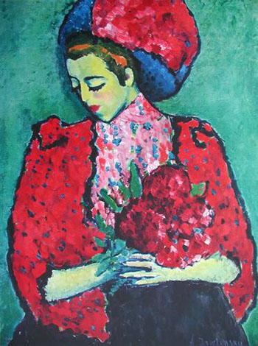
4 attributes or characteristics of the German Expressionistic school:
the use of solid, bright, and often primary colors
the feeling of Movement
the rendering of non-photographic or realistic yet clearly identifiable subjects
a strong emotional content
the use of broad and identifiable brush strokes
http://education.ucsb.edu/webdata/instruction/hss/Concept_Attainment/GermanExpressionism.pdf
Alexej Jawlensky, Girl with Peonies, 1909

Slide 3
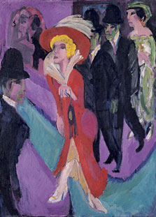
In a broader sense Expressionism is one of the main currents of art in the later 19th
and the 20th centuries. http://education.ucsb.edu/webdata/instruction/hss/Concept_Attainment/GermanExpressionism.pdf
It developed almost simultaneously in different countries from about 1905...and lasted until c. 1925...German Expressionism in particular tended to dwell on the darker, sinister aspects of the human psyche.
http://www.gordscafe.net/id85.html
Ernst Ludwig Kirchner,
Red Streetwalker, 1914

Slide 4
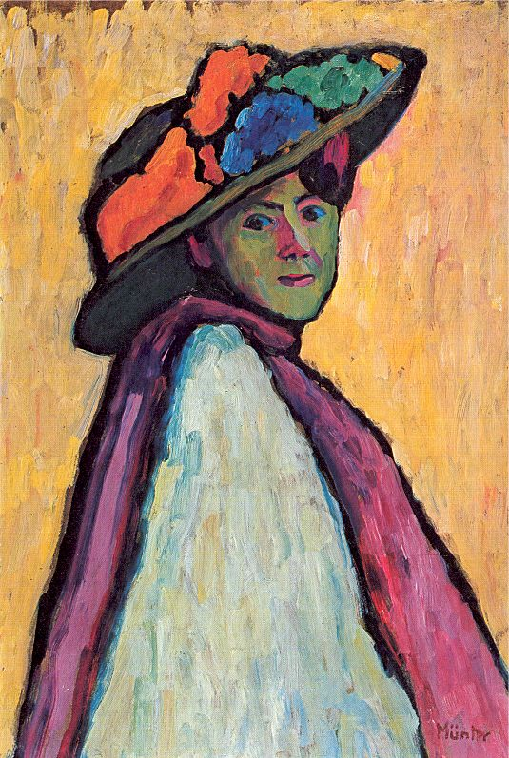
Expressionism is an artistic style in which the artist attempts to depict not objective reality but rather the subjective emotions and responses that objects and events arouse in him. He accomplishes his aim through distortion, exaggeration, primitivism, and fantasy and through the vivid, jarring, violent, or dynamic application of formal elements.
http://education.ucsb.edu/webdata/instruction/hss/Concept_Attainment/GermanExpressionism.pdf
Gabriele Münter, Portrait of Marianne von Werefkin, 1909

Slide 5
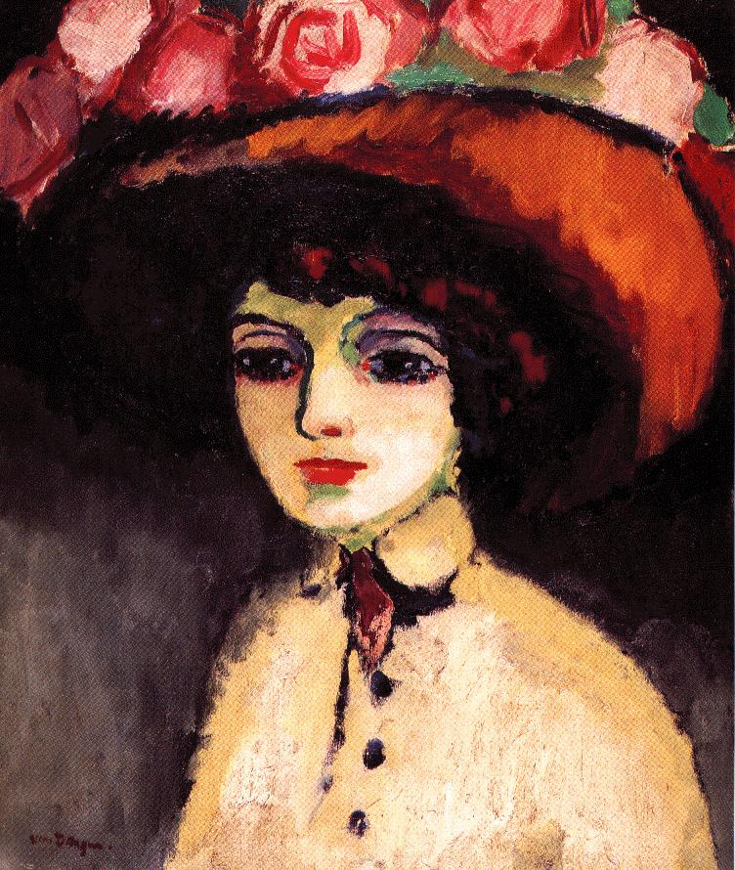
Kees van Dongen, La parisienne de Montmartre, 1911

Slide 6
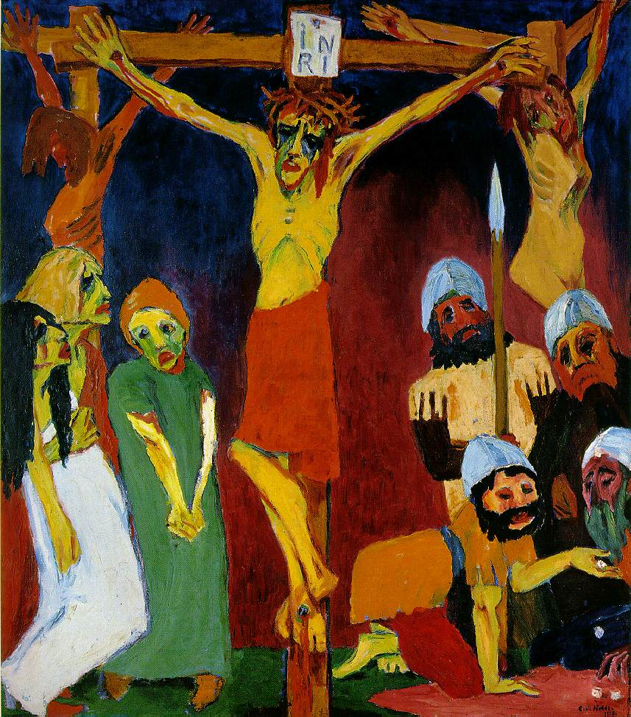
Is this artwork Expressionist?
Emil Nolde, Crucifixion, 1912

Slide 7
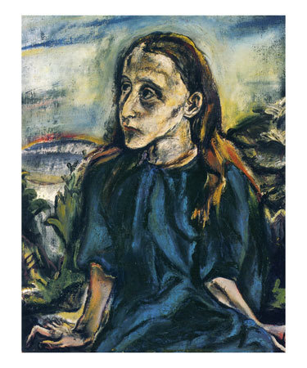
Oskar Kokoschka, Portrait of a Young Girl, c. 1913

Slide 8
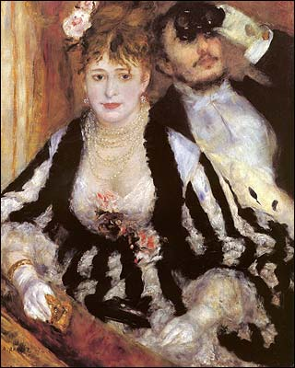
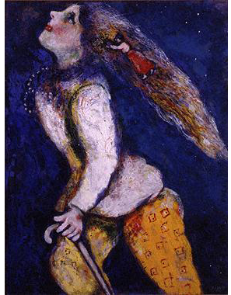
Auguste Renoir, The Balcony Seat, 1874
Marc Chagall, Young Girl in Pursuit, 1927

Slide 9
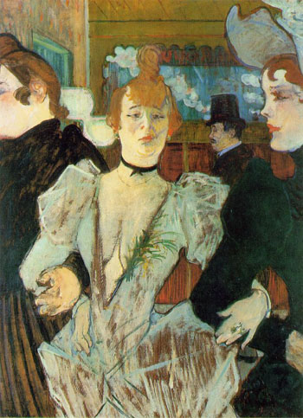
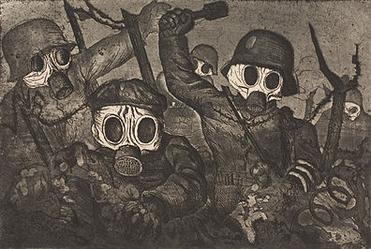
Otto Dix, Stormtroops Advancing under gas, 1924
Henri Toulouse-Lautrec, La
Goulue, 1892

Slide 10
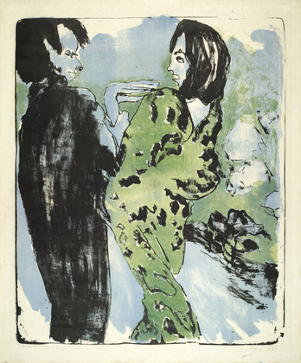
German Expressionists include:
Max Beckmann,
Otto Dix,
Lionel Feininger,
George Grosz,
Ernst Ludwig Kirchner,
August Macke,
Emil Nolde,
Max Pechstein,
Oskar Kokoschka (Austrian),
Alfred Kubin (Czech) ,
Edvard Munch (Norwegian),
Gabriele Münter,
Alexej Jawlensky
Emil Nolde, Young Couple, 1913

Slide 11
TASK:
PART 1:
Look for images in the classroom Art Text or online, which were created by one of the Expressionist Artists listed (or any others you may find). Pick one work of figurative Expressionist art and create a quick sketch in your sketchbook. Use gesture drawing strategies.
PART 2:
Find a magazine or newspaper image depicting strong/negative emotions (fear, anger, sadness, instability, anguish, etc.). Paste image in your sketchbook. Recreate the image using gesture drawing strategies. Layer appropriate colour (pencil crayon, pastel) on top of drawing in the style of the Expressionist artists.

